Slide 1
How to Delete your Account and Information from an NK Site
Go to the website in which you have an account and sign in at the top.

Slide 2
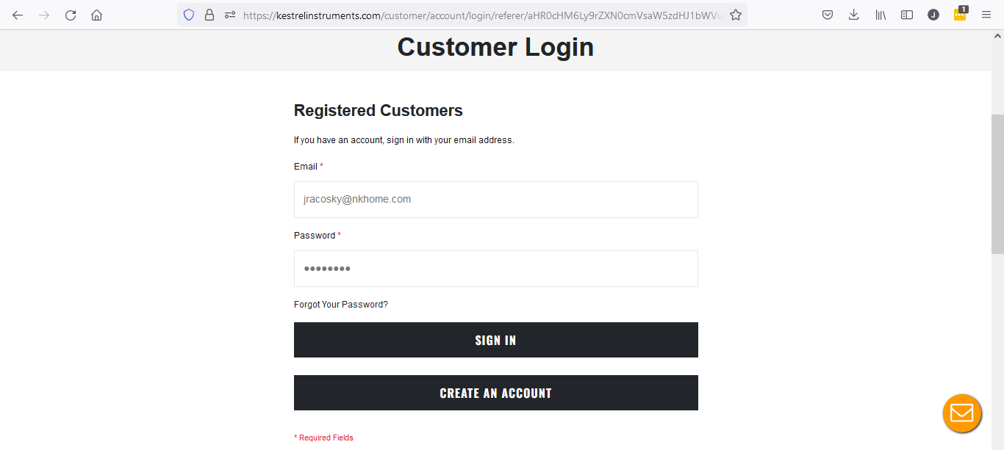
Enter your username and password. If you have forgotten your password, you can request a new one.

Slide 3
Enter your username and password. If you have forgotten your password, you can request a new one.

Slide 4
Click on the down arrow and select My Account.

Slide 5
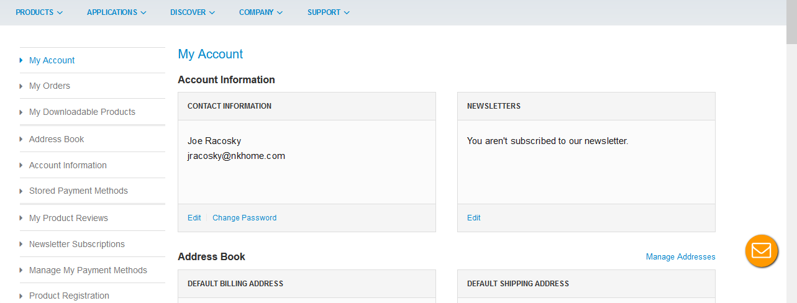
John Doe
jondoe@msn.com
With My Account chosen on the left, scroll down to the bottom of the page.

Slide 6
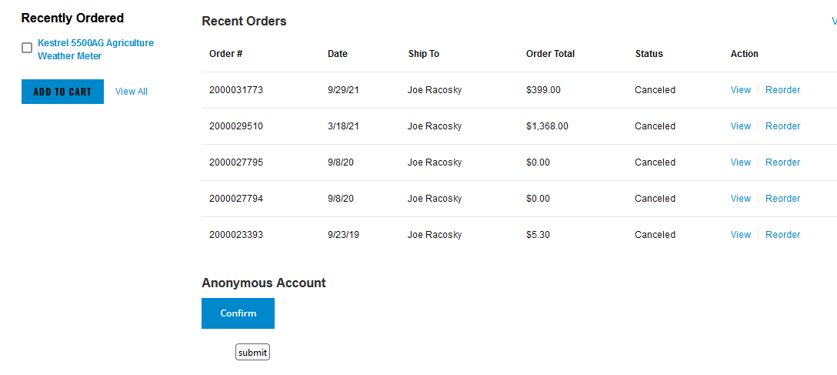
John Doe
Locate the Anonymous Account heading. Click on Confirm.

Slide 7
You will need to reenter your password. Once entered, click Submit and your data will be removed and anonymized.

